Slide 1
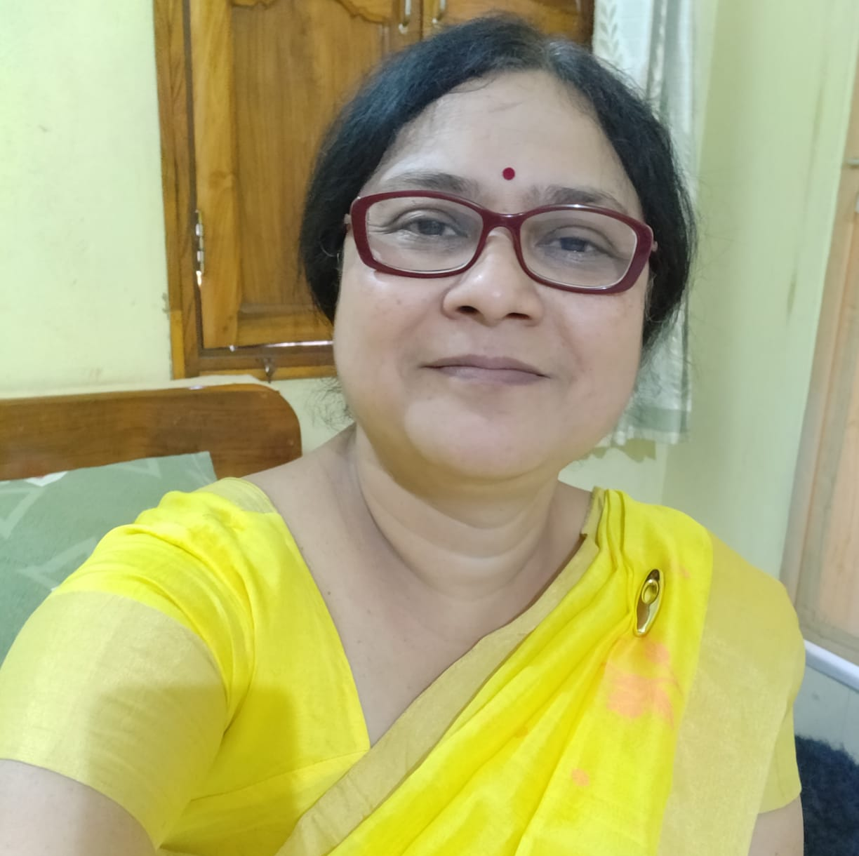
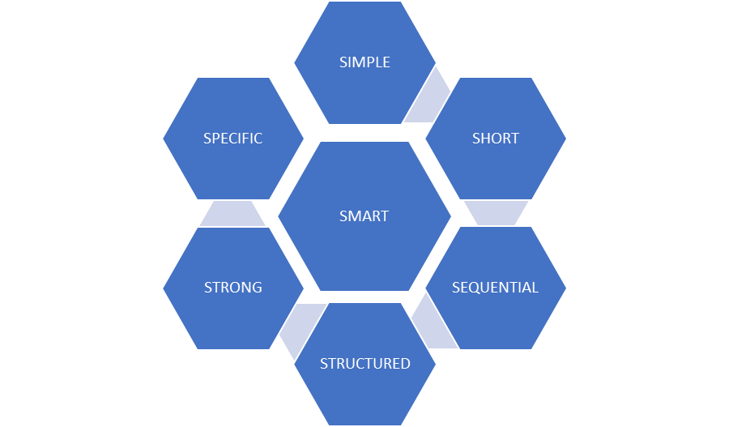
Dr Sharmistha Behera CHAIRPERSON SCIENTIFIC COMMITTEE OSOS 2021 NOV
OSOS aims at adding the 7th S
SMART to scientific approach

Slide 2
DEC 2021 INTERNATIONAL DAY FOR PERSONS WITH DISABILITY
Click to follow

Slide 3
JAN 2022
Recording: click to Follow

Slide 4
FEB 2022
Click to follow

Slide 5
MARCH 2022
1. Topic: OSOS Celebrates Glaucoma Week 2022Start Time: Mar 6, 2022 09:28 PM Meeting Recording:
2. Topic: OSOS Celebrates Glaucoma Week 2022Start Time: Mar 6, 2022 09:20 PMMeeting Recording
3 Topic: OSOS Celebrates Glaucoma Week 2022Start Time: Mar 6, 2022 07:01 PM Meeting Recording

Slide 6
APRIL 2022
OSOS Sports related eye injuries

Slide 7
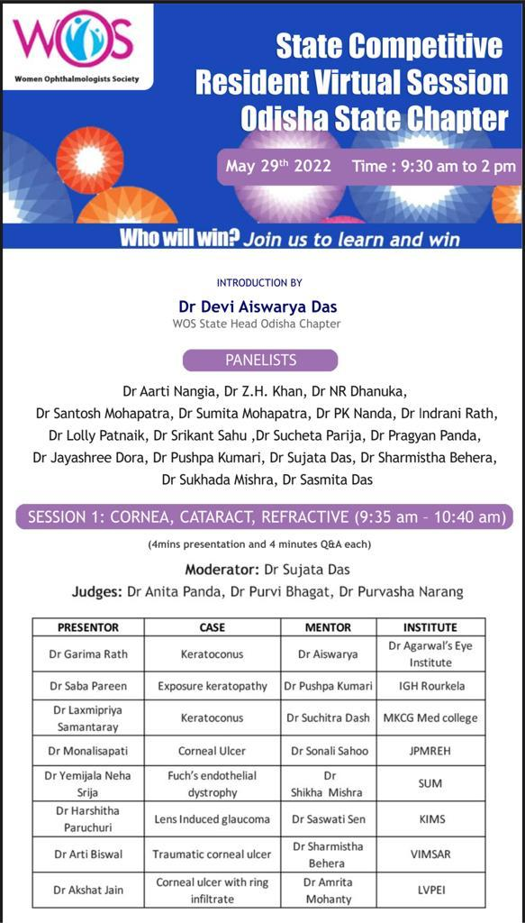
MAY 2022, WOS PG CASE PRESENTATION
click to Follow

Slide 8
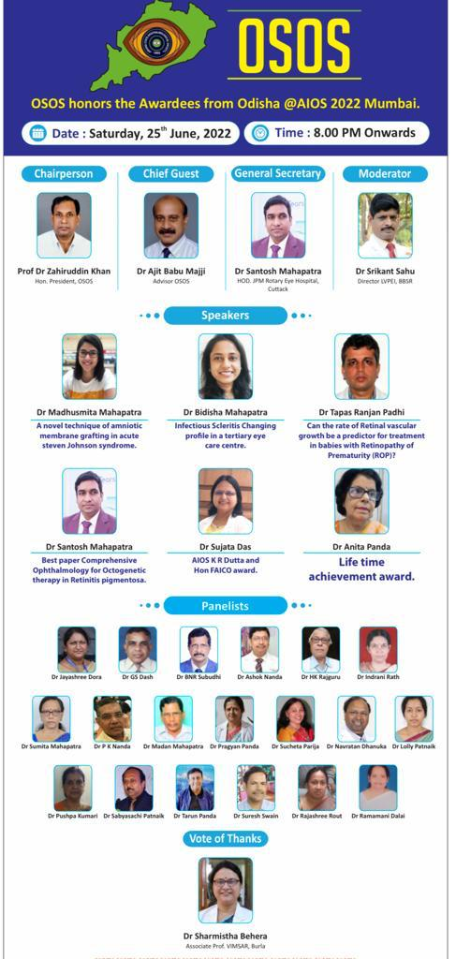
JUNE 2022 TO HONOR AIOC 2021 AWARDEES FROM ODISHA
click to Follow

Slide 9
Plan for July to Dec 2022
To Continue…

